Slide 1
Agreement Protocols
Edited Slides of Prof Pallab Dasgupta

Slide 2
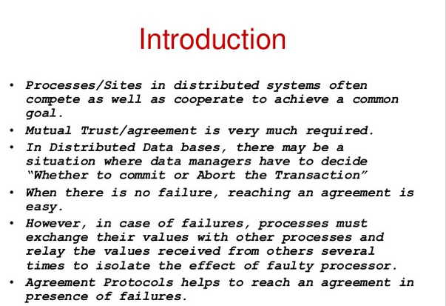

Slide 3
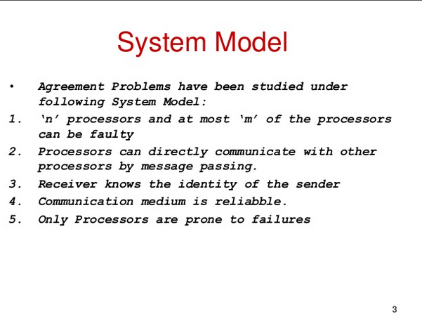

Slide 4
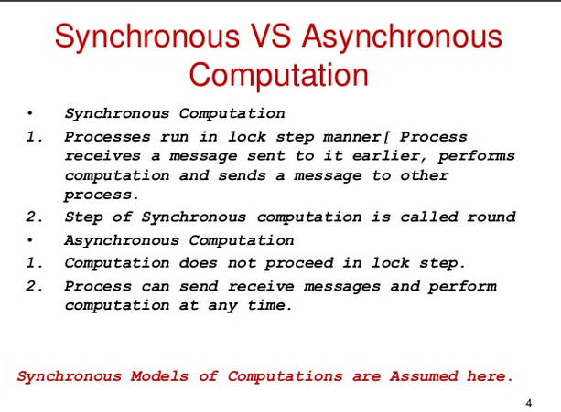

Slide 5
Applications of Consensus in Distributed Systems
Designed to achieve reliability in a network involving multiple unreliable nodes.
Required for decisions like
- Whether to commit a distributed transaction to a database
Consensus on leader (leader election)
What is the current value of the variable

Slide 6
Crash Failures: Process crashes and remains down for the rest of the computation Byzantine faults: No crashes but components behave in a malicious way. It will try to mislead the other processes.

Slide 7
Consensus Algorithm for Crash Failures (synchronous system)
n processes,
upto f < n processes may fail.
Crash failure indicates that the node can crash before/between/after sending msgs but wont send wrong messages. Once it crashes it stops participating in any further activity forever.
All processes need to agree on the initial value of one of the processes . The value agreed upon can also be that of a crashed process. Statement: If there are at most f faulty processes; then, in f+1 rounds, the algorithm reaches agreement for f<n.

Slide 8
Consensus Algorithm for Crash Failures (synchronous system)
n processes,
upto f < n processes may fail.
Crash failure indicates that the node can crash before/between/after sending msgs but wont send wrong messages. Once it crashes it stops participating in any further activity forever.
The consensus variable x is integer value.
Each process has an initial value xi.
Upto f+1 rounds are executed
In each round process pi sends its value xi to all process if that value has not been sent before.
Process pi then takes min of all values received in the round and its own value.
Updates its own value to the min calculated
At the end of f+1 rounds all correct processes decide the same value.

Slide 9
Consensus Algorithm for Crash Failures (synchronous system)
Code for each processor:
v := my input
at each round 1 through f+1:
if I have not yet sent v then send v to all
wait to receive messages for this round
v := minimum among all received values and
current value of v
if this is round f+1 then decide on v

Slide 10
Correctness of Crash Consensus Algo
Termination: By the code, finish in round f + 1.
Validity: Holds since processors do not introduce spurious messages
if all inputs are the same, then that is the only value ever in
circulation.

Slide 11
Correctness of Crash Consensus Algo
Agreement: Statement: If there are at most f faulty processes; then, in f+1 rounds, the algorithm reaches agreement for f<n.
Suppose in contradiction p_{j} decides on a smaller value, x, than does p_{i}.
Then x was hidden from p_{i} by a chain of faulty processors:
There are f + 1 faulty processors in this chain, a contradiction.
round
1
round
2
round
f
round
f+1
q₁
q₂
q_{f}
q_{f+1}
p_{j}
p_{i}

Slide 12
Proof of correctness
Suppose correct processes Pi and Pj do not decide on the same value where Pj decides on a smaller value. The only way that Pi did not receive the smaller value x is if
all the processes in the sequence in which pj received it were faulty and
pj himself received it only at the f+1th round due to which he could not send this to all processes.
Now, - If Pj received it before round f+1 then pi would have received it in the f+1 th round.
If Pj received it at the f+1th round that means that all the processes on the path from the original process with min value till Pj were all faulty but you can have only f faulty processes and there are f+1 rounds. So atleast one process was non faulty and would have relayed this min information to Pi as well.

Slide 13
Performance of Crash Consensus Algo
Number of processors n > f
f + 1 rounds
Each round you have n² messages (each process to n-1 processes = n(n-1))
Thus total number of messages = (f+1) n²
Algorithm works even for n-1 crashes as long as you run it for n rounds.

Slide 14
Any protocol will require at least f+1 rounds to come to a consensus in the presence of at most f byzantine processes where the number of processes has to be 3f+1

Slide 15
Byzantine Agreement Problem
A designated process (source) with an initial value has to reach an agreement with the other processes about its initial value under the following conditions:
Agreement: All non faulty processes must agree on the same value
Validity: A decided value is the proposed value if the source is non faulty
Termination: Every correct process returns a value (decides)
Process is Byzantine if it deviates from some specification
-behave as crashed process
Send wrong information
-send different information to different processes

Slide 16
Byzantine Agreement
One process x broadcasts a value v
Agreement Condition: All non-faulty processes must agree on a common value.
Validity Condition: The agreed upon value by non faulty processes must be v if x is non-faulty. The agreed upon value can be any value (may not be v) if x is faulty.

Slide 17
Variants of Byzantine agreement problem
Consensus
Each process broadcasts its initial value
All non-faulty processes must agree on a common value.
If initial value of all non-faulty processes is v, then the agreed upon value must be v
Interactive Consistency
Each process k broadcasts its own value v_{k}
All non-faulty processes agree on a common vector (v₁,v₂,…,v_{n})
If the k^{th} process is non-faulty and its initial value is v_{k}, then the k^{th} value in the vector agreed upon by non-faulty processes must be v_{k}. If kth process process is faulty then the kth value agreed upon by the non faulty process can be any value
Solution to Byzantine agreement problem implies solution to other two

Slide 18
Byzantine solution for Interactive Consistency
Solving Interactive Consistency using the Byzantine Solution
Interactive Consistency: Each process k broadcasts its own value v_{k.} All non-faulty processes agree on a common vector (v₁,v₂,…,v_{n}). If the k^{th} process is non-faulty, then the k^{th} value in the vector agreed upon by non-faulty processes must be v_{k}
Run the Byzantine solution on each process. Let the value broadcast by process 1 to n be v₁,v₂,…,v_{n.}
By the Byzantine solution, for each process Pi initiating the byzantine agreement solution, every non faulty process will agree on its value vi. Thus every non faulty process has agreed on the same value for each process that has initiated. The vector (v₁,v₂,…,v_{n}) is thus known and the same for every non faulty process. Satisfies Interactive Consistency

Slide 19
Interactive Consistency for Consensus
Solving Consensus Problem using Interactive Consistency Consensus Problem: Each process broadcasts its initial value
All non-faulty processes must agree on a common value.
If initial value of all non-faulty processes is v, then the agreed upon value must be v
Run the Interactive Consistency solution. Each non faulty process lands up with a common vector. Use a function that decides which among these to pick. Majority,min, max etc function could be used.
Hence given a solution to the Byzantine Problem we have a solution to both Consensus and Interactive Consistency Problem

Slide 20
Overview of Results
Agreement impossible in asynchronous case.
Even if we only want to tolerate a single crash failure.
True both for message passing and shared read-write memory. In a synchronised system, all systems will stop at certain points, sychronise and then move forward together. We study algorithms further for a sychronised setting.

Slide 21
Byzantine Agreement Problems
Model :
Total of n processes, at most m of which can be faulty
Reliable communication medium
Fully connected
Receiver always knows the identity of the sender of a message
Byzantine faults: behave as crashed, send wrong msgs or different mgs
Synchronous system
In each round, a process receives messages, performs computation, and sends
messages.

Slide 22
Byzantine Agreement Problem
No solution possible if:
asynchronous system, or
n < (3m + 1) where n =#generals, m=#faulty generals. (2/3 non faulty majority needed)
Lower Bound:
Needs at least (m+1) rounds of message exchanges
“Oral” messages – messages can be forged / changed in any manner, but the receiver always knows the sender

Slide 23
Byzantine Agreement:All non-faulty processes must
agree on a common value. The agreed upon value by
non faulty processes must be v if x is non-faulty.
Byzantine solution does not exist for N=3 and f=1
S
S
0
0
1
1
0
T
U
0
1
T
U
1
Scenario-1: S has to decide 0. Since loyal generals hence T decides 0
Scenario-2: Here S and U must agree. S has to decide 1. U decides on 1
S
Scenario-3: T’s situation is same as Scenario 1 and U’s as scenario 2. T decides 0, U decides 1.
Here T and U should agree but couldnt
0
1
0
T
U
1

Slide 24
Assume that a byzantine soln does not exist for N<=3f and f faulty generals. This is shown by reducing Z(3,1) to Z( N<=3f,f) where Z (a,b) is the byzantine solution for a generals with b faculty generals among them.

Slide 25
Lamport-Shostak-Pease Algorithm
Algorithm Broadcast( N, t ) where t is the resilience
For t = 0, Broadcast( N, 0 ):
Pulse
1 The general sends ⟨value, x_{g}⟩ to all processes,
the lieutenants do not send.
Receive messages of pulse 1.
The general decides on x_{g}.
Lieutenants decide as follows:
if a message ⟨value, x⟩ was received from g in pulse-1
then decide on x
else decide on udef

Slide 26
Lamport-Shostak-Pease Algorithm contd..
For t > 0, Broadcast( N, t ):
Pulse
1 The general sends ⟨value, x_{g}⟩ to
all processes, the lieutenants
do not send.
Receive messages of pulse 1.
Lieutenant p acts as follows:
if a message ⟨value, x⟩ was
received from g in pulse-1
then x_{p} = x else x_{p} = udef ;
Announce x_{p} to the other
lieutenants by acting as
a general in
Broadcast_{p}( N – 1, t – 1 ) in
the next pulse
Pulse
t +1 Receive messages of pulse t +1.
The general decides on x_{g}.
For lieutenant p:
A decision occurs in
Broadcast_{q}( N – 1, t – 1 ) for
each lieutenant q
W_{p}[q] = decision in
Broadcast_{q}( N – 1, t – 1 )
y_{p} = majoity (W_{p})

Slide 27
Example PDF

Slide 28
Conclusion
In case of a faulty general all the arrays of the correct processes are the same.
Example: For two correct process Pi and Pk
If Pi has 001101 then Pk too has 001101
In case of a loyal general, all correct process agree on the same value. That is, the subarray compassing of the positions of the loyal lieutanents of every correct process has the same bit (either 0 or 1). Say among the 6 (N) bits the first 4 (first 2N/3) are those of the loyal lieutenants and the last 2 (last N/3 )are of the faulty ones. Then for two correct process Pi and Pk then
If Pi has 111101 then Pk has 111110. The first four bits will be the same for all.

Slide 29
To Prove all correct processes decide on the same value
Two cases: General is loyal
General is not loyal

Slide 30
Loyal general
Lemma: If the general is correct, if there are f faulty processes , and if N>2f+t, then all correct processes decide on the input of the general.
Proof:
Base case: for Broadcast(N,0) general and all lieutenants agree on the same value. Assume Lemma true for N-1.
Since N>2f+t so N-1>2f+t-1. That is, if non faulty are atleast N-t then now too non faulty are at least N-1- (t-1)=N-t
By Induction Hypothesis: For Broadcast (N-1,t-1) if we assume the Lemma to be true, then for each broadcast of form B(N-1,t-1) by a loyal process pi , all loyal lieutenants will decide on the input sent by pi(say x). Hence the local array of every process would have recorded its decision for B(N-1,t-1) by pi as x for every correct pi. Now, when each array looks at the majority in his local array he finds x as the majority as correct generals are >= 2(N-1)/3. Hence each correct pi decides x. Thus in N,t we have atleast 2N/3 deciding x .

Slide 31
Faulty general
Lemma: Given t, the algorithm is correct if t>=f and there are a total of 3t+1 or more processes.
Base Case: For t=0, the lieutenants will just take the value of the general and decide on it hence all correct processes decide the same value.
Proof:
Base case: for Broadcast(N,0) general and all lieutenants agree on the same value. If general in B(N-1,t-1) is non faulty, we assume the general and all non faulty processes decide the same value. Consider 4 processes A, B, C D where A, B are faulty and C,D are non faulty. Consider the vectors of C and D. C[C] and D[C] are the same by lemma on non faulty generals. Similarly C[D] and D[D] are the same. Assuming the Lemma is true for broadcast(N-1,t-1) for faulty general where if t>=f nd N> 3t then t-1>f-1 and N-1>3(t-1); we have all non faulty processes agreeing on the same value even if general is faulty. Thus, C[A] and D[A] is same and similarly C[B] and D[B] is same as C, D will agree on the same value even for faulty generals A and B . Hence, for faulty general we have vector C = vector D. That is, all non faulty processes have the same vector. Hence, taking majority they decide on the same value. For non faulty general we proved in the previous lemma

Slide 32
Faulty general (cont)....
Lemma: Given t, the algorithm is correct if t>=f and there are a total of 3t+1 or more processes.
Base Case: For t=0, the lieutenants will just take the value of the general and decide on it hence all correct processes decide the same value.
Assume true for t=x. To show the lemma is correct for t=x+1
Since at t=x we have if x>=f then x+1>=f+1. Also we now have atleast 3(x+1)+1 =3x+4 processes of which at most x+1 could be faulty.
If the general is loyal: Previous lemma shows that algorithm is correct
If the general is faulty: Then after the faulty general msgs the lieutenants, we have x remaning faulty generals and more than 3x+1 generals. Using the induction hypothesis, each non faulty process can compute the consensus value. That is, every non faulty process Pi knows the consensus that each other process (faulty or non faulty) would have reached as the reached consensus by some Pk is the majority of his own array when he participated in the broadcast by Pk. That is, all non faulty process have the same array for all the processes (faulty and non faulty). Hence, the majority deicded by each non faulty process is the same as all have the same arrays.

Slide 33
Home Work
Read Paxos- achieves consensus among a distributed set of computers that communicate via an asynchronous network. Provides aboratable consensus. https://people.cs.rutgers.edu/~pxk/417/notes/paxos.html
Raft: https://www.freecodecamp.org/news/in-search-of-an-understandable-consensus-algorithm-a-summary-4bc294c97e0d/

Slide 35
Features
Termination: If Broadcast( N, t ) is started in pulse 1, every process decides in pulse t + 1
Dependence: If the general is correct, if there are f faulty processes, and if N > 2f + t, then all correct processes decide on the input of the general
Agreement: All correct processes decide on the same value
The Broadcast( N, t ) protocol is a t-Byzantine-robust broadcast protocol for t < N/3
Time complexity: O( t + 1 ) Message complexity: O( N^{t} )

Slide 36
Current status:
We have systems for authenticating msgs today. Hence if some process forges a received message or tampers with it before relaying it ahead, then, the receipient can detect the forgery. Thus faulty processes can inflict less damage.

Slide 37
Byzantine solution does not exist for - not to be done N generals and N/3 faulty generals
Idea: Let the protocol that achieves agreement for N<=3f generals and f faulty general be
represented as P(N<=3f,f ). Then, to show that P(3,1) is solvable. Howver we have already shown that P(3,1) cant be solved. Hence P(N<=3f,f) cant be solved
Reduction: From P(3,1) to P(N<=3f,f)
Idea: Put all f faulty generals into one group G1 and the others into two more groups G2 and G3. Each group has at most N/3 generals. In our system of 3 processes P1, P2 and P3 let P1 simulate G1, P2 simulate G2 and P3 simulate G3.
Simulate would mean that whatever would be done by the processes in G1 is now done as local computations inside P1. Any exchange of information between nodes of Gi and Gj is now done between Pi and Pj. However we know that P1, P2, P3 can not reach an agreement when one of them is faulty. Hence contradiction.
Why cant I put more than N/3 into G2 and G3 to show that it cant work any N,f? The reduction is recursive and that is why groups have to be of equal size.
Notes:
The last 2 lines are not clear to me! So avoid this proof.

Slide 38
For crash failure, if actual crahes is f+1 then is consensus sure to fail? No. may fail. Suppose all processes send each other in first round and then failed. Is no fault the worst case scenario for crash failure algorithm? No, if no fault then end of first round everyone gets everyones msgs. Finds min. In second round everyone sends each other the sme min value and so no third round. What is worst case scenario? Q1 holds min. sends to q2 and no one else and fails. So in round f the fth failure nodes sends to node q(f+1) and fails. In Round f+1 everyone gets the min and stops. Number of msgs:

